Slide 1
BOOTP
The Bootstrap Protocol (BOOTP) is a client/server protocol that configures a diskless computer or a computer that is booted for the first time. BOOTP provides the IP address, net mask, the address of a default router, and the address of a name server.

Slide 2
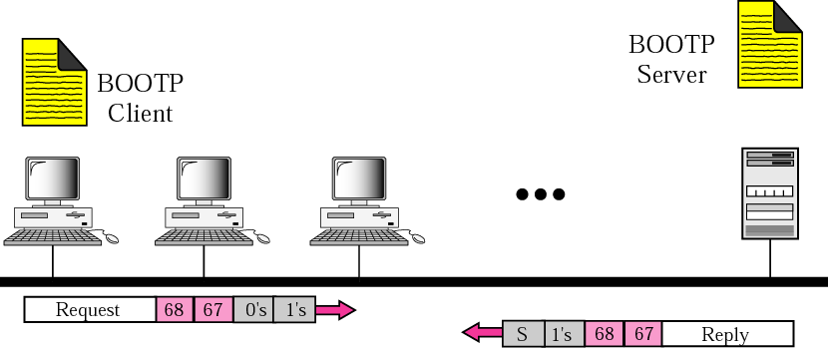
Client and server on the same network

Slide 3
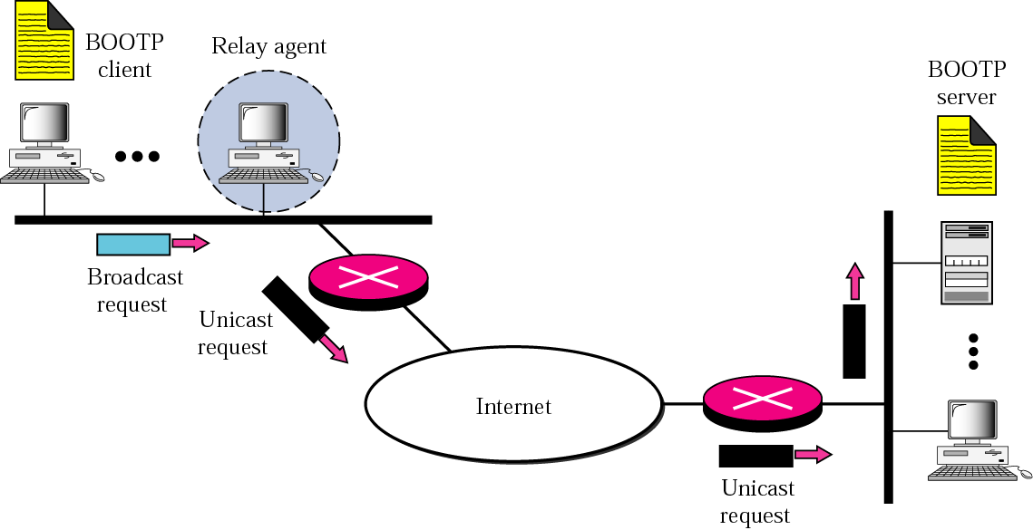
Client and server on two different networks

Slide 4
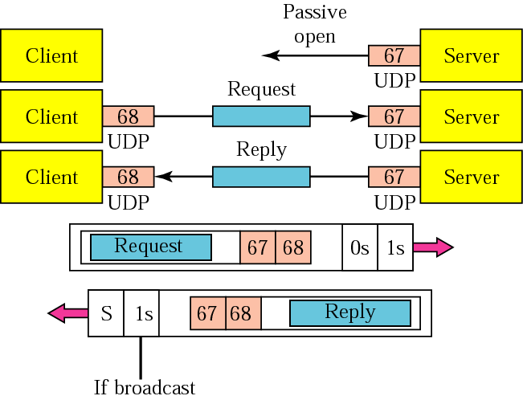
Use of UDP ports

Slide 5
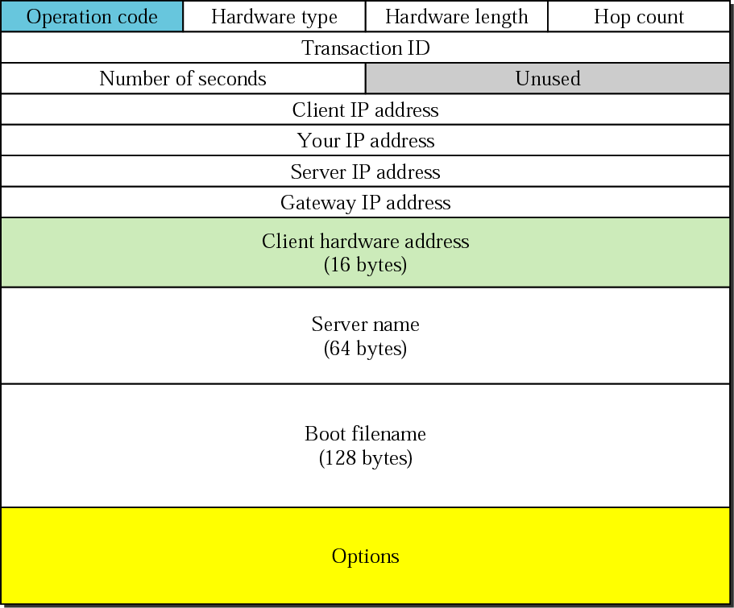
BOOTP packet format

Slide 6
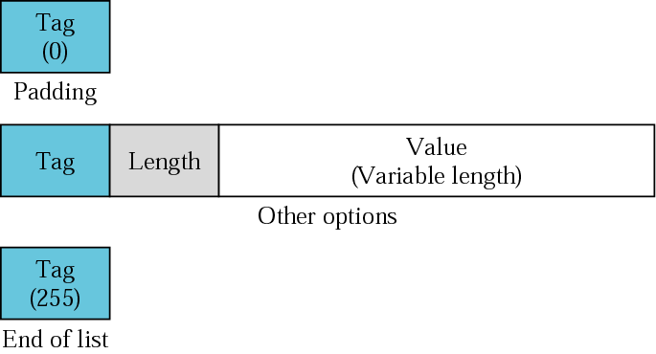
Option format

Slide 7
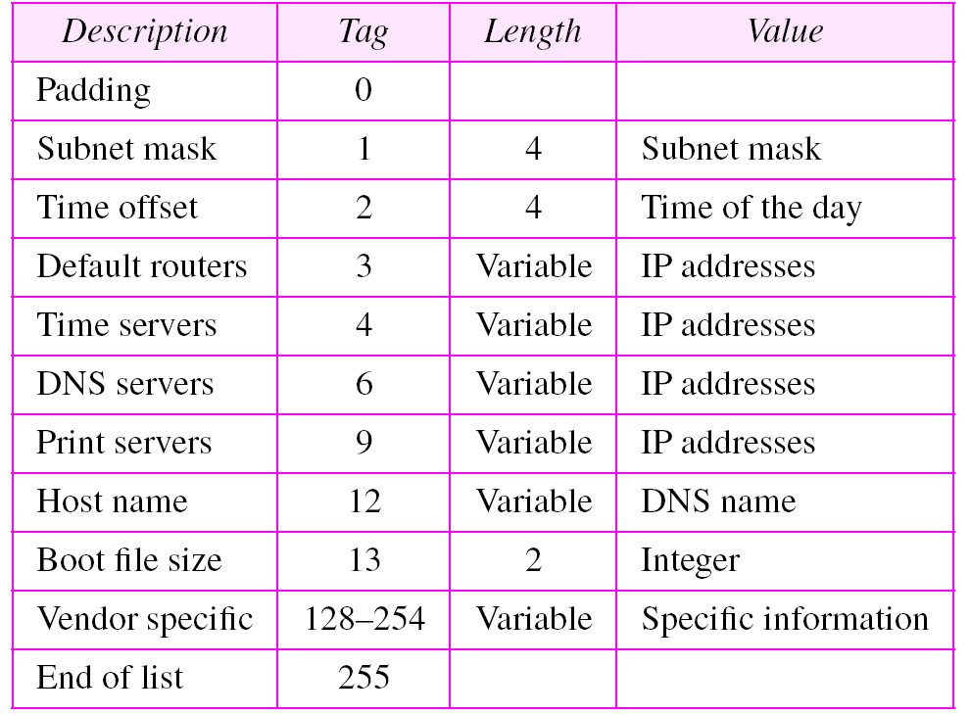
Options for BOOTP

Slide 8
DHCP
The Dynamic Host Configuration Protocol (DHCP) provides static and dynamic address allocation that can be manual or automatic.
Static Address Allocation
Dynamic Address Allocation
Manual and Automatic Configuration
Packet Format
Transition States
Exchanging Messages

Slide 9
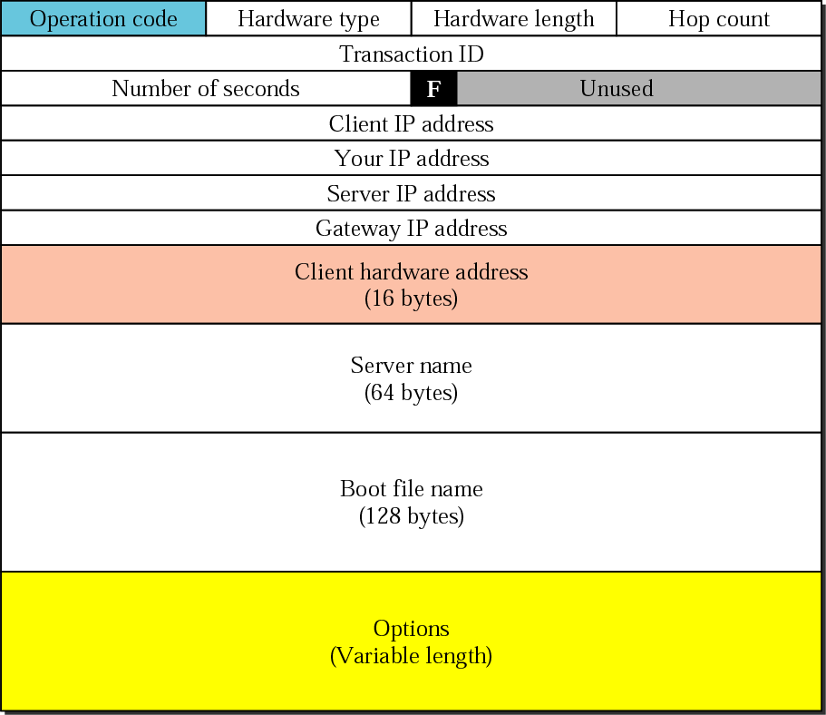
DHCP packet

Slide 10
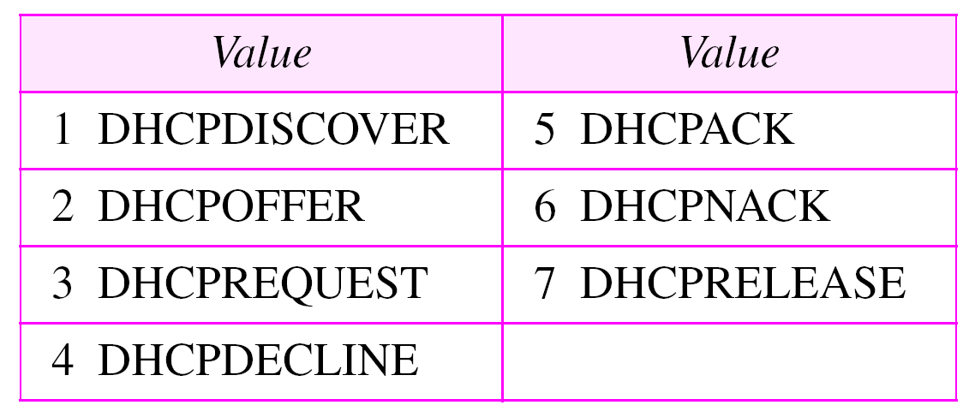
Options for DHCP

Slide 11
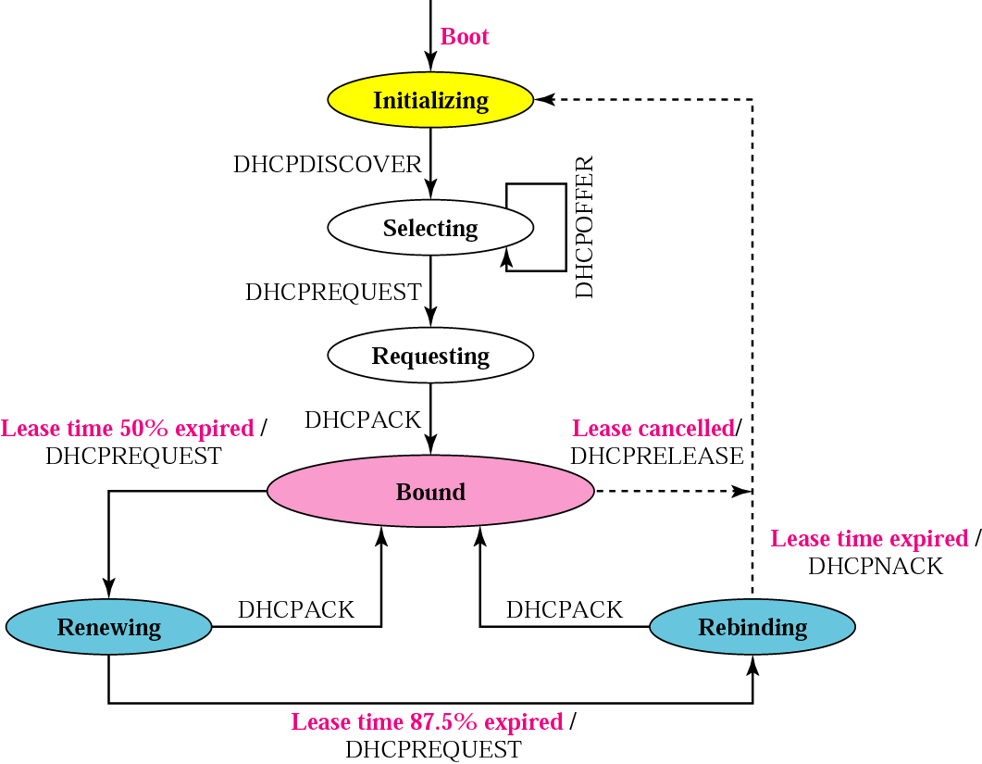
DHCP transition diagram

Slide 12
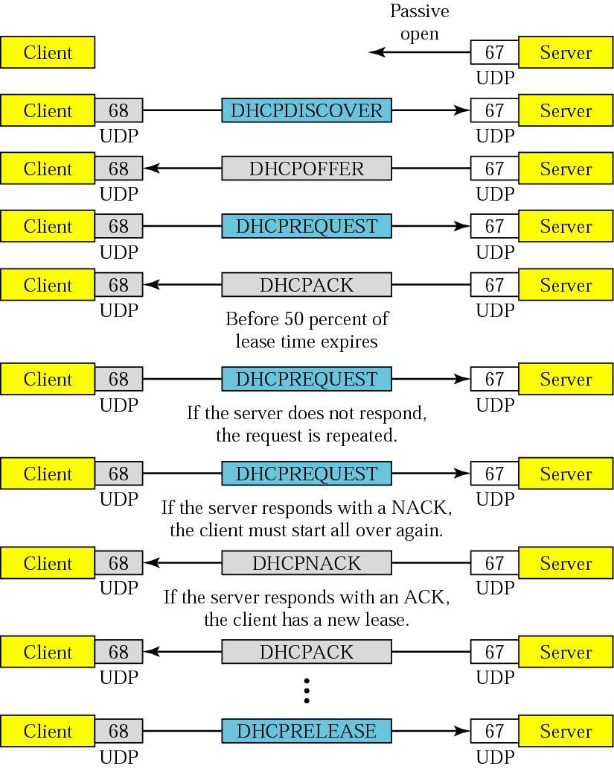
Exchanging messages

